Slide 1
Moving Forward – Understanding True Value
Philippians 3: 4 to 11

Slide 2
ScriptureOAP

Slide 3
¹ Further, my brothers and sisters, rejoice in the Lord! It is no trouble for me to write the same things to you again, and it is a safeguard for you. ² Watch out for those dogs, those evildoers, those mutilators of the flesh. ³ For it is we who are the circumcision, we who serve God by his Spirit, who boast in Christ Jesus, and who put no confidence in the flesh— ⁴ though I myself have reasons for such confidence.
If someone else thinks they have reasons to put confidence in the flesh, I have more: ⁵ circumcised on the eighth day, of the people of Israel, of the tribe of Benjamin, a Hebrew of Hebrews; in regard to the law, a Pharisee; ⁶ as for zeal, persecuting the church; as for righteousness based on the law, faultless.

Slide 4
⁷ But whatever were gains to me I now consider loss for the sake of Christ. ⁸ What is more, I consider everything a loss because of the surpassing worth of knowing Christ Jesus my Lord, for whose sake I have lost all things. I consider them garbage, that I may gain Christ ⁹ and be found in him, not having a righteousness of my own that comes from the law, but that which is through faith in Christ—the righteousness that comes from God on the basis of faith. ¹⁰ I want to know Christ—yes, to know the power of his resurrection and participation in his sufferings, becoming like him in his death, ¹¹ and so, somehow, attaining to the resurrection from the dead.

Slide 5
SObservationAP

Slide 6
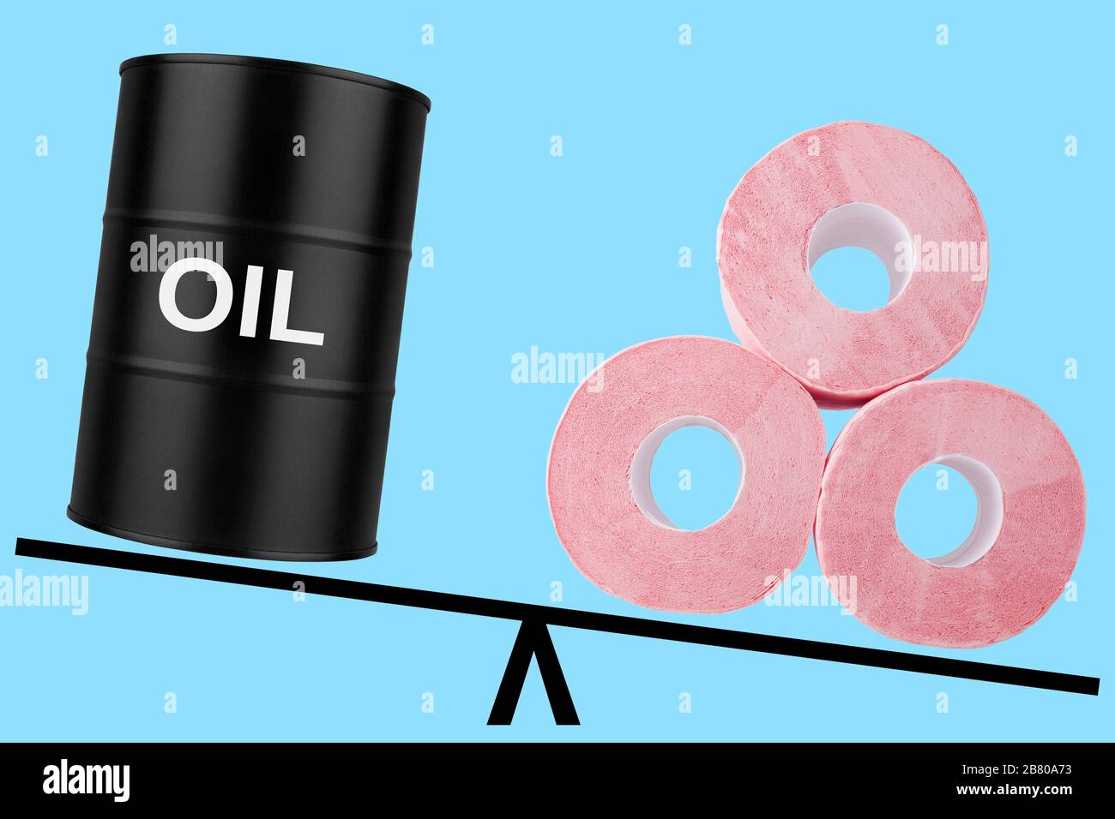
Values change with many things - age, circumstances….

Slide 7
What Paul valued before conversion (v 5-6)
+
-
Born a Jew.
Member of an important family.
A Pharisee, full of zeal. A judge through persecution.
Faultless in legalistic practice.
………….
?

Slide 8
What Paul valued after conversion (V 7-8)
+
-
Knowing Christ Jesus

Slide 9
Paul sets aside his very identity and possessions to take know Jesus
⁴⁴ “The kingdom of heaven is like treasure hidden in a field. When a man found it, he hid it again, and then in his joy went and sold all he had and bought that field.
⁴⁵ “Again, the kingdom of heaven is like a merchant looking for fine pearls. ⁴⁶ When he found one of great value, he went away and sold everything he had and bought it. Matthew 13:44-46

Slide 10
Three levels of knowing Jesus
Intellectual - to know of
Experiential – to know by
Intimate – to know fully.

Slide 11
1. Intellectual knowledge
Knowing facts about Christ wasn’t what Paul was after.
Simply believing that He exists was not enough for him.
Paul wanted to know Christ on a deeper level.

Slide 12
2. Experiential knowledge
I’ve been to many Christian camps and so forth where people have a Jesus experience. But many times there is no lasting effect. They have known the presence and power of Jesus Christ. They have experienced Him, but nothing permanent happened.
“On judgment day many will tell me, ‘Lord, Lord, we prophesied in your name and cast out demons in your name and performed many miracles in your name.’ But I will reply, ‘I never knew you. Go away; the things you did were unauthorized.’” Matthew 11: 22,23 (NLT)

Slide 13
3. Intimate knowledge
³⁸ As Jesus and the disciples continued on their way to Jerusalem, they came to a village where a woman named Martha welcomed them into her home. Her sister, Mary, sat at the Lord’s feet, listening to what he taught. But Martha was worrying over the big dinner she was preparing. She came to Jesus and said, “Lord, doesn’t it seem unfair to you that my sister just sits here while I do all the work? Tell her to come and help me.”
But the Lord said to her, “My dear Martha, you are so upset over all these details! There is really only one thing worth being concerned about. Mary has discovered it—and I won’t take it away from her.” Luke 10: 38-42 (NLT)

Slide 14
3. Intimate knowledge – True and only Value
Paul said he wanted to know Christ. This is what he was talking about. He wanted the kind of intimate knowledge of Jesus that Mary was seeking.
Even after serving he didn’t think he had arrived.
He knew that his intimate relationship with Christ could still grow. He wanted to know Christ in His fullness, and in fact, to become like Christ.

Slide 15
SOApplicationP

Slide 16
How to have an intimate knowledge of Jesus
1. Talk with Him
The biggest part of any relationship is communication.
2. Learn about Him
In building a relationship it’s important to learn about the other person.

Slide 17
Seven steps to intimate knowing of Jesus
3. Memorize His Word
I have hidden your word in my heart, that I might not sin against you. Psalm 119:11 (NLT)
How does memorizing the Bible help this to happen? It gets you thinking about things that are pure and good.
4. Read a Devotional Book.

Slide 18
Seven steps to intimate knowing of Jesus
5. Worship Him
Regular worship directs your attention and energies toward God and reinforces His priority in your life.
6. Be Involved in a Connect Group
7. Commune with Others
Become a vital part of a local church.

Slide 19
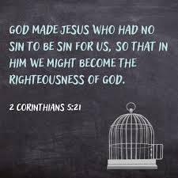
It’s all for and about gaining God’s Righteousness
God’s approval or being considered right in His eyes

Slide 20
SOAPrayer

